Slide 1
Unit II
Object Oriented Analysis

Slide 2
contents
Use case modelling
Domain /class modelling
Association
Generalization/specialization
Aggregation/composition

Slide 3
Use case modelling
The Use-case model is defined as a model which is used to show how users interact with the system.
The use case model defines the user's objective, the interactions between the system and the user, and the system's behavior required to meet these objectives.
Various model elements are contained in use-case model, such as actors, use cases, and the association between them.
The use-case model acts as an integrated thread in the development of the entire system.

Slide 4
Components of Basic Model
There are various components of the basic model:
Actor
Use Case
Associations
Actor :
Actors are people involved with the system defined on the basis of their roles.

Slide 5
Components of Basic Model
Use case:
The use case defines how actors uses a system to accomplish a specific objective.
Associations :
It is used to define the associations among actors and use cases they contribute in.

Slide 6
Actor identification
The operating environment of a software system consists of the users, devices, and programs that the system interacts with. These are called actors.
Types of actors include:
users database systems clients and servers platforms devices

Slide 7
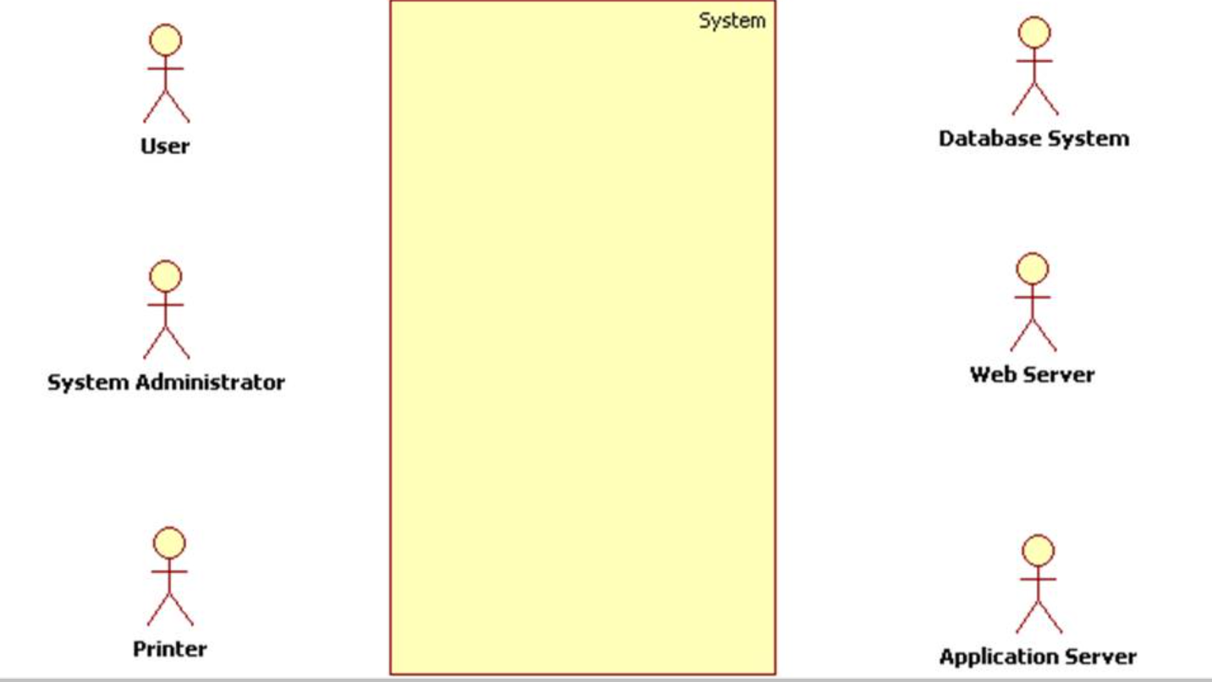

Slide 8
Actor identification
Actors (and the system itself) are simply classes of objects that inhabit the system's operating environment and interact with the system.
Therefore we can replace the actor icon with a class icon of stereotype <<actor>>:

Slide 9
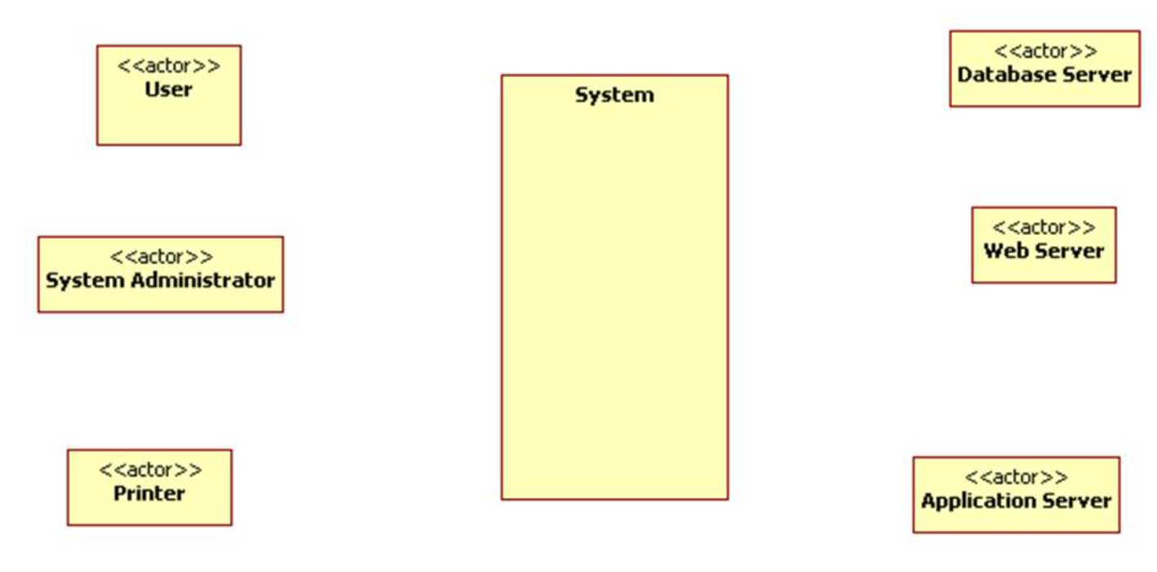

Slide 10
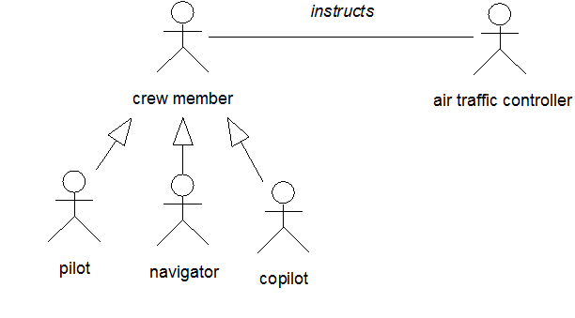
Actor identification
Since actors are classes, we can model associations and generalizations between them using class diagram notation:

Slide 11
Actor identification
The following rules are applied to verify actors in a use case diagram.
Every actor has a unique name in the diagram. If the diagram includes more than one actor with the same name, they are logically combined into one actor.
An actor must be represented by its unique symbol.
Every actor must have at least one association in the diagram.
An actor can have at most one association with a use case.
An actor may be connected with another actor through a generalization relationship.

Slide 12
Actor classification
Actors are classified into
Primary actors (also called active actors) and
Secondary actors (also called passive actors).
A primary actor initiates an interaction with the system.
The system initiates interactions with secondary actors.

Slide 13
Actor classification
There is another way to classify actors, they can be:
Human
Systems / Software
Hardware
Timer / Clock

Slide 14
Actor generalization
Actor generalization refers to the relationship which can exist between two actors and which shows that one actor (descendant) inherits the role and properties of another actor (ancestor).
The generalization relationship also implies that the descendant actor can use all the use cases that have been defined for its ancestor.
Actors in UML are classes and the generalization is simply the inheritance relationship between two actors by which one actor inherits all the properties and relationships of another actor.

Slide 15
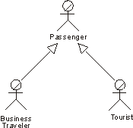
Actor generalization

Slide 16
Use case identification
Before we can produce a use case diagram we must first identify the groups of related scenarios - the use cases.
To identify use cases we will take the following steps:
Step 1: Identify candidate system actors.
Step 2: Identify the goals of the actors.
Step 3: Identify the candidate use cases.
Step 4: Identify the start point for each use case.
Step 5: Identify the end point for each use case.
Step 6: Refine and scope units of interaction.

Slide 17
Use case identification
Step 1: Identify candidate system actors.
Read through the requirements documentation and make a note of all the candidate system actors.
Remember an actor is not just a person but may also be an external system such as a credit card verification service.
Actors interact with the system and reside outside of it.

Slide 18
Use case identification
Step 2: Identify the goals of the actors.
Use cases describe the functionality required of the system in order for actors to achieve their goals.
Therefore you need to identify what the goals of your candidate actors are.
Step 3: Identify the candidate use cases.
Remember a use case represents a substantial piece of system functionality, not just a single method in software.
Use cases cover a group of related scenarios, for example, a use case called "purchase ticket" will include the scenario where payment is unsuccessful in addition to the typical payment success scenario.
Choose an initial name to describe the candidate use case and paste the textual commentary from the requirements document underneath the use case name.

Slide 19
Use case identification
Step 4: Identify the start point for each use case.
You may have already started to do this when producing your list of candidate use cases but you need to identify the start point for each use case.
To do this, look for an actor and an initial event.
Step 5: Identify the end point for each use case.
In a manner similar to that of step 2, you need to identify the beneficial result of the use case, the end point.
The purpose of this step is to allow you to refine the size of use cases

Slide 20
Use case identification
Step 6: Refine and scope units of interaction.
At this point all of the functionality described in the requirements document needs to be covered by at least one candidate use case.
You now need to work through the list of candidate use cases refining size and scope.

Slide 21
Uses association
Often, objects and/or methods of one class use objects/methods from another class.
For example, a person might read and/or own a book, and these relationships might be modeled in the UML diagram, so that they will be implemented in the corresponding program.
UML class diagrams include the following types of use-relationships, in order from weakest to strongest.

Slide 22
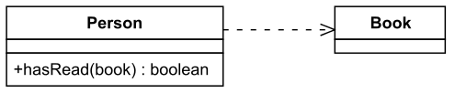
Uses association
Dependency:
An object of one class might use an object of another class in the code of a method.
If the object is not stored in any field, then this is modeled as a dependency relationship.
For example, the Person class might have a hasRead method with a Book parameter that returns true if the person has read the book (perhaps by checking some database).

Slide 23
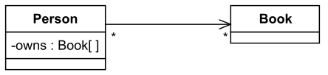
Uses association
Unidirectional Association:
An object might store another object in a field.
For example, people own books, which might be modeled by an ”owns” field in Person objects.

Slide 24
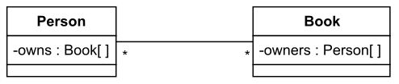
Uses association
Bidirectional Association:
Two objects might store each other in fields.
For example, in addition to a Person object listing all the books that the person owns, a Book object might list all the people that own it.

Slide 25
Include association
Include relationship show that the behavior of the included use case is part of the including (base) use case.
The main reason for this is to reuse common actions across multiple use cases.
In some situations, this is done to simplify complex behaviors.
Few things to consider when using the <<include>> relationship.
-The base use case is incomplete without the included use case.
-The included use case is mandatory and not optional.

Slide 26
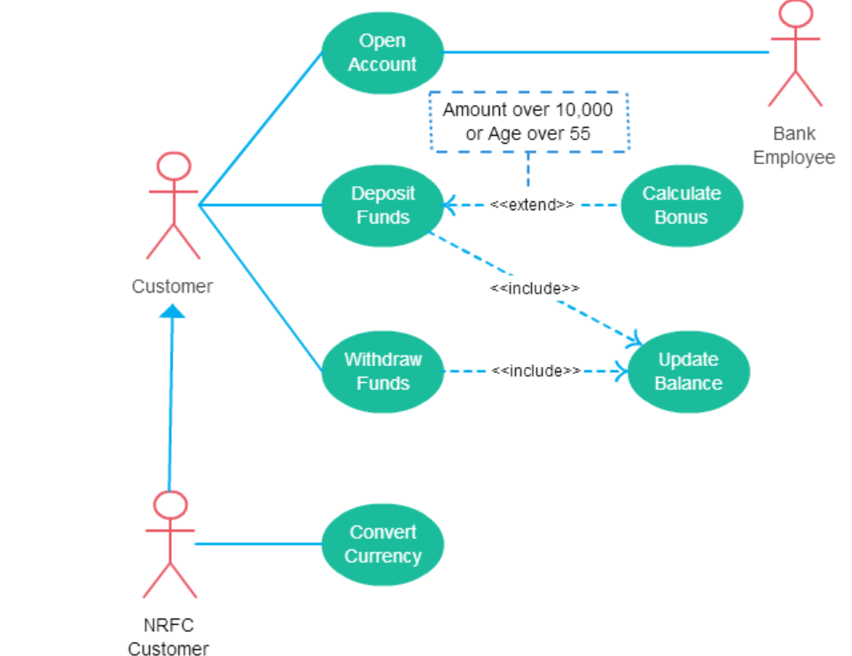
Fig: banking system use case diagram to show include relationships

Slide 27
Extend association
Few things to consider when using the <<extend>> relationship.
The extending use case is dependent on the extended (base) use case. In the below diagram the “Calculate Bonus” use case doesn’t make much sense without the “Deposit Funds” use case.
The extending use case is usually optional and can be triggered conditionally. In the diagram, you can see that the extending use case is triggered only for deposits over 10,000 or when the age is over 55.
The extended (base) use case must be meaningful on its own. This means it should be independent and must not rely on the behavior of the extending use case.

Slide 28
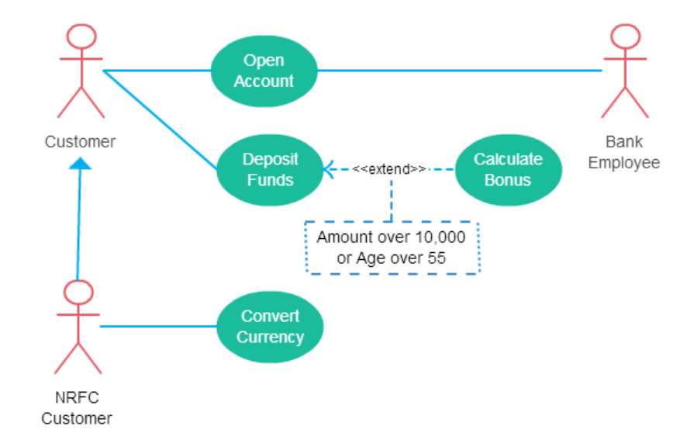
Fig: Banking example to show the <<extend>> relationship.

Slide 29
Writing formal use cases
The formal, or classic use case, is a tool used to gather structured information about how users will use the software.
Formal use cases are gathered in a template, which structures the information.
The two main benefits of having the structure are that it helps with thoroughness and it helps with scanning by readers of the document.

Slide 30
Writing formal use cases
Here are the elements of a formal use case, with explanations:
Meta data:
This is the information that identifies when the use case was first written and by whom.
It may also include revision information, who made the changes, what was changed, and when and why it was changed.

Slide 31
Writing formal use cases
Title:
The title of a use case is like a title of a essay .e.g.”My Summer Vacation”.
The title is intended to provide enough information to identify what the use case represents without reading the use case.
This can be useful when getting an overview of a planned project, validating requirements, or when scanning use cases as part of reviewing materials.
Some examples:
Pilot performs pre-flight safety check.
Author adjusts plot element timelines.
Accountant reconciles accounts-receivable ledger.

Slide 32
Writing formal use cases
Description :
A brief description of the activity represented in the use case.
One to five sentences – no more than a single paragraph – describing the activity or process represented by the use case.
The description does not include the full details, but does provide the “next level of insight” into understanding what the use case covers.
Some examples:
A pilot peforms an FAA mandated list of equipment and operational inspections prior to every flight.

Slide 33
Writing formal use cases
Primary actor:
The primary actor is the person who is the subject of the use case, performing the verb of the use case on the object.
A use case may have multiple actors but has one most important person.
The term actor represents the person who takes action – not someone playing a role.
Some examples:
Primary Actor: Pilot. Secondary Actors:Flight Crew, Sr. Maintenance Technician
Primary Actor: Author.
Primary Actor: Financial Accountant. Secondary Actor: Financial Accounting Manager

Slide 34
Writing formal use cases
Triggers:
A trigger is the outside event that triggers the beginning of a use case.
This is an event that initiates a use case.
Many use cases do not have an obvious trigger – and the trigger will be documented as “User decides to do X.”
Some examples:
Pilot receives flight plan.
Author initiates review of the novel.
It is the first day of the last month of the quarter.

Slide 35
Writing formal use cases
Preconditions:
Preconditions are the set of things that must be true for the use case to occur.
These represent a contract of sorts – the use case will not happen unless all of the preconditions are met.
Some examples:
Flight plan has been approved.
None. (In our example, the author can review timelines before during or after completing a draft of the novel.)
Accounts receivable entries have been made in the ledger.

Slide 36
Writing formal use cases
Post conditions:
Post-conditions represent the other side of the contract. If the normal course (see below) of the use case has been completed, then these things must be true.
Some examples:
The plane has been confirmed to be safe and ready for the approved flight plan.
The timeline is updated to reflect the author’s desired result.
All accounting entries have been reconciled or identified as being incorrect.

Slide 37
Writing formal use cases
Normal Course
The preferred, desired, or most common sequence of events that represent the use case.
This sequence of events must be followable in the solution.
The normal course is documented as a series of single actor, single action sentences, each with a number.
An example:
Accountant accesses current quarter accounts-receivable ledger information.
Each of the following steps is repeated for every entry in the ledger.
Accountant confirms transaction record matches appropriate other ledger (sales, billing, etc).
Accountant updates ledger to indicate that the entry was confirmed.

Slide 38
Writing formal use cases
Alternate courses:
Alternate course are supported alternatives to the normal course.
Each variation is identified as an alternative, and each step that varies from the normal course will be explicitly defined within the alternative course.
An example:
A1: Incorrect ledger entry identified.
A1.3. Accountant confirms that the ledger record does not match the appropriate other ledger.

Slide 39
Writing formal use cases
Exception Courses:
An exception course identifies how the system should behave when something goes wrong in the normal course.
An example:
E1: Unable to access accounts receivable ledger
E1.1. Accountant fails to access accounts receivable ledger information.

Slide 40
Writing formal use cases
Includes:
Sometimes use cases are broken down into smaller, reusable use cases (such as login steps, using a search window to find an account, etc).
A reference to another use case from the includes section indicates that the referenced use case is a subset of this use case.
An example:
The use case of “Accountant Prepares Quarterly Report” could include the use case of “Accountant reconciles accounts-receivable ledger”.

Slide 41
Writing formal use cases
References/Traces :
Each use case is written to support one or more market requirements (goals).
The specific goals that are being supported will be identified as references, or traces.
References or traces to each of these requirements will be identified in this section.

Slide 42
Writing formal use cases
Assumptions :
All assumptions that are implicit in the rest of the use case will be explicitly documented here.
Examples:
Pilot is certified to run a safety-check.
Airport allows pilot to run her own safety-check.

Slide 43
Writing formal use cases
Notes :
Any text that helps the author or potentially helps the reader is documented as notes.
These are not requirements documented in the use case, any more than notes in the margin of a book are part of the book.
Conclusion :
With this understanding, reading any formal use case will be a breeze.

Slide 44
Use case realization
A use-case realization represents how a use case will be implemented in terms of collaborating objects.
The realizations reside within the design.
The realization can take various forms.
It may include, for example, a textual description (a document), class diagrams of participating classes and subsystems, and interaction diagrams (communication and sequence diagrams) that illustrate the flow of interactions between class and subsystem instances.

Slide 45
Use case realization
The reason for separating the use-case realization from its use case is that doing so allows the requirements, in the form of use cases, to be managed separately from the design, in the form of realizations.
In a model, a use-case realization is represented as a UML (Unified Modeling Language) collaboration that groups the diagrams and other information.
A first pass in creating the realization might produce a diagram at an analysis level of abstraction.
The participants will be high-level elements that are expected to be revisited and detailed down to the design level in a second pass.

Slide 46
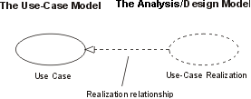
Use case realization

Slide 47
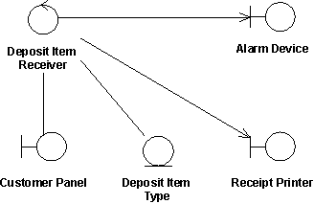
Class diagrams owned by a use case realization
For each use-case realization, there may be one or more class diagrams that depict its participating classes.
A class and its objects often participate in several use-case realizations.
While designing, it is important to coordinate all of the requirements related to a class that different use-case realizations may have.

Slide 48
Domain /class modeling
The four alternative approaches for identifying classes:
The noun phrase approach.
The common class patterns approach.
The use-case driven, sequence/collaboration modeling approach.
The classes, responsibilities and collaborators (CRC) approach.

Slide 49
Domain /class modeling
Noun phrase approach
Look for the noun phrases through the use cases.
Three categories:
Relevant classes.
Fuzzy classes.
Irrelevant classes.
Identifying tentative classes.
Some classes are implicit or taken from general knowledge.
All classes must make sense in the application domain.
Carefully choose and define class names.

Slide 50
Domain /class modeling
The common class patterns approach: The common class patterns approach is based on a knowledge base of the common classes that have been proposed researchers. The patterns used for finding the candidate class and object are:
Concept class
Events class
Organization class
People class
Places class
Tangible things and devices class

Slide 51
Use case driven approach:
It is the third approach that is recommended.
Use case modelling is considered a problem driven approach to object oriented analysis which means designer first consider the problem at hand and not relationship between object.
Modelling use case is useful for finding objects of a system.
The process of creating sequence or collaboration diagrams is a systematic way to think about how a use case can take place and think about objects involved in your system.
Example given in a book shared to you OOAD page no.166,167.

Slide 52
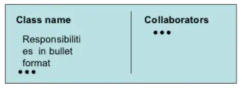
Domain /class modeling
The classes, responsibilities and collaborators (CRC) approach:
Classes, responsibilities, and collaborators is a technique used for identifying classes’ responsibilities, and collaborators and therefore their attributes and methods.
CRC is based on the idea that an object either can accomplish a certain responsibility itself or it may require the assistance of other objects. CRC cards are 4”``X 6`` index cards in which all the information for an object is written is cheap, portable, readily available and familiar.

Slide 53
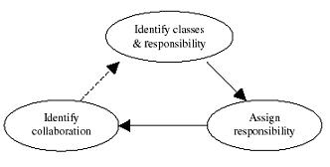
Domain /class modeling
Steps in CRC process The classes, responsibilities and collaborators process consists of three steps:
Identify classes responsibilities (and identify classes).
Assign responsibilities.
Identify collaborators.

Slide 54
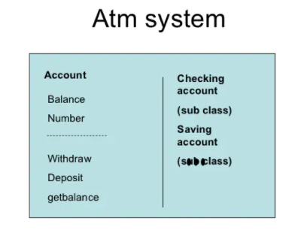
Domian /class modeling

Slide 55
Naming classes
It is an important activity.
There are some guidelines for naming classes:
The class name should be singular. The class should describe a single object ,so it should be the singular form of noun.
You should use names with which the users or clients are comfortable. Use the standard vocabulary.
Use readable names. Capitalize class names. By convention ,the class name must begin with an upper case letter. For compound words ,capitalize the first letter of each word. E.g.LoanWindow.

Slide 56

Class association
Association represents physical and conceptual connection between two or more objects.
E.g.object responsibility is telling another object that credit card number is valid or invalid. Here two classes have association.
Binary association are shown as lines connecting two class symbols.
Ternary and higher order association are shown as diamonds connecting to a class symbol by lines.
Association name is written above or below the line.

Slide 57
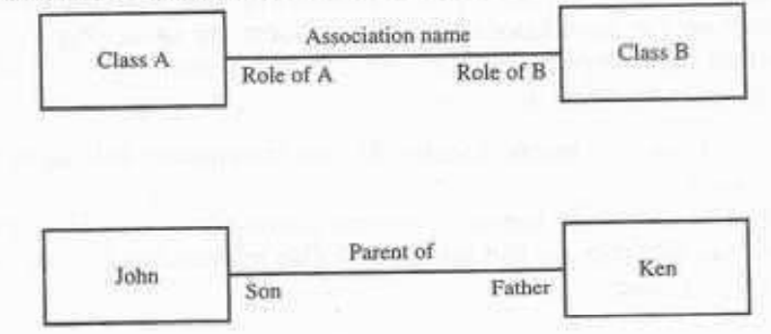

Slide 58
Identifying association
Identifying association begin by analysing the interactions between classes.
Wirfs-Brock ,Wilkerson and Wiener provide following questions that can helps to identify association:
Is the class capable of fulfilling the required task by itself?
If not ,what does it need?
From what other class can it acquire what it needs?
Answering these questions helps us identify association.

Slide 59
Identifying association
Guidelines for identifying association:
A dependency between two or more classes may be association. Association often corresponds to a verb or prepositional phrase ,such as part of ,next to,works for or contained in.
A reference from one class to another is an association. Some associations are implicit or taken from general knowledge.

Slide 60
Common association patterns
Common association patterns are based on some of the common associations defined by researchers,these include :
Location association -next to ,part of ,contained in.
E.g. consider a soup object ,cheddar cheese is part of soup.
Communication association –talk to ,order to.
E.g. customer places an order with an operator person.

Slide 61
Degree of an Association
Degree of an association denotes the number of classes involved in a connection. Degree may be unary, binary, or ternary.
A unary relationship connects objects of the same class.
A binary relationship connects objects of two classes.
A ternary relationship connects objects of three or more classes.

Slide 62
Cardinality Ratios of Associations
There are three types of cardinality ratios, namely −
One–to–One − A single object of class A is associated with a single object of class B.
One–to–Many − A single object of class A is associated with many objects of class B.
Many–to–Many − An object of class A may be associated with many objects of class B and conversely an object of class B may be associated with many objects of class A.

Slide 63
generalization
Generalization is the process of extracting shared characteristics from two or more classes, and combining them into a generalized superclass.
Shared characteristics can be attributes, associations, or methods.
If many similar existing objects are combined to form a superclass to do the job of its subclass', then it is known as Generalization

Slide 64
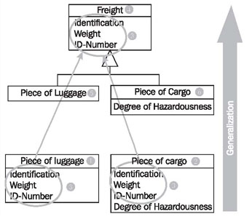
generalization
During generalization, the shared characteristics (3) are combined and used to create a new superclass Freight (4). Piece of Luggage (5) and Piece of Cargo (6) become subclasses of the class Freight.

Slide 65
specialization
Specialization is the reverse process of generalization. Here, the distinguishing features of groups of objects are used to form specialized classes from existing classes.
The class Freight (1) has the attribute Degree of Hazardousness (2), which is needed only for cargo, but not for passenger luggage.
Through specialization the two special cases of freights are formed: Piece of Cargo (3) and Piece of Luggage (4). .
only passenger luggage has a connection to a coupon.

Slide 66
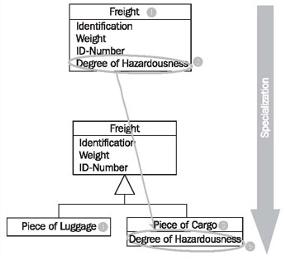

Slide 67
Identifying attributes and methods
Identifying attributes and methods is like finding classes ,still a difficult activity and an iterative process.
Use cases will be our guide to identify attributes,methods and relationship among classes.
Identifying attributes of a system’s classes starts with understanding the system’s responsibility.
Following questions will help in identifying attributes and methods:
What information about an object should we keep track of?
What services must a class provide?

Slide 68

Aggregation/composition
Aggregation or composition is a relationship among classes by which a class can be made up of any combination of objects of other classes.
It allows objects to be placed directly within the body of other classes.
Aggregation is referred as a “part–of” or “has–a” relationship, with the ability to navigate from the whole to its parts.
An aggregate object is an object that is composed of one or more other objects.

Slide 69
Aggregation/composition
Example-
-In the relationship, “a car has–a motor”, car is the whole object or the aggregate, and the motor is a “part–of” the car. Aggregation may denote −
Physical containment − Example, a computer is composed of monitor, CPU, mouse, keyboard, and so on.
Conceptual containment − Example, shareholder has–a share.

Slide 70
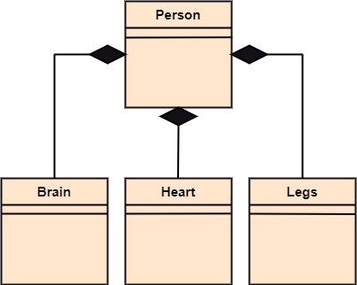

composition
The composition is a part of aggregation, and it portrays the whole-part relationship.
It depicts dependency between a composite (parent) and its parts (children), which means that if the composite is discarded, so will its parts get deleted.
It exists between similar objects.

